Slide 1
MOAT ACADEMY
WEB APPLICATION DEVELOPMENT TRAINING
CSS Box Model2, Positioning and Semantic Divs – Day 3

Slide 2
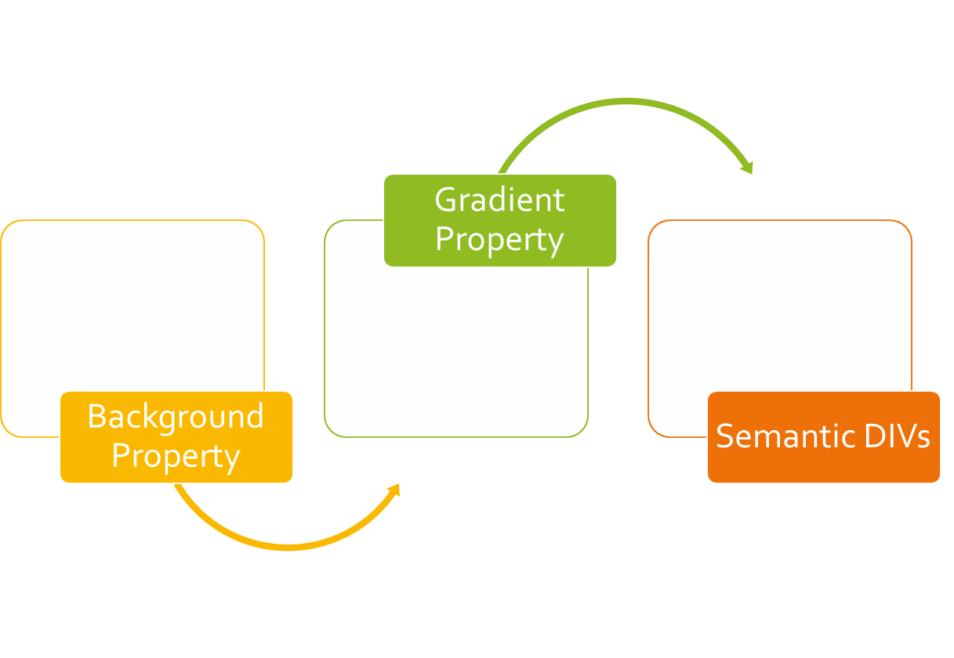
CLASS
OUTLINE

Slide 3
CSS BOX MODEL 2
The model describes the space of the content taken by an element. An element is represented by a box and each box has four edges

Slide 4
BORDER PROPERTIES
The following are the properties used in affecting your border in CSS
border-style: double, dashed, solid, dotted, none type
border-width: thin, medium, thick 1px thickness
border-color: rgb or hex or name
border-radius: used in creating rounded borders. Can be specified in px or %, eg 5px . To create a complete round box, the element must have equal width and height, border-radius must be 50%
Each of the properties can have up to 4 values for the top, right, bottom and left. See below* :
  border-right-style: double OR border-top-style: dashed
Notes:
If you do not specify the side, all the four sides will take the values.
To make a circle from a box
<p style="width:100px; height:100px; border:1px solid red; border-radius:50%"></p>

Slide 5
BORDER SHORTCUT- combining all border properties in “border”
We can specify border using the CSS border property. This property needs three values to display border properly. They are: The width of the border, style (solid, dashed, dotted, double) of the border and the color of the border.
All elements have some imaginary border ; specifying the border style allows you to make the imaginary border “Real” hence the most important property is the style. If you omit it, colors , width etc wont work – you would be trying to color an invisible border!

Slide 6
OUTLINE
outline: 2px solid rgb(224, 33, 138);

Slide 7
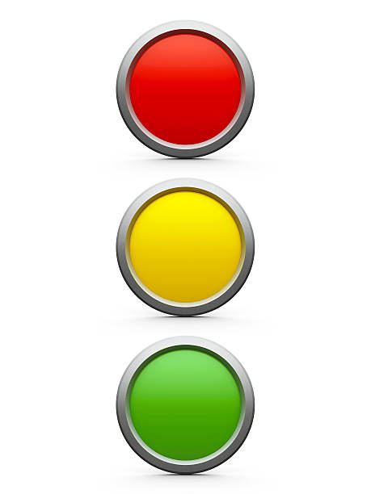
EXERCISE – 10 Mins
Teach a 4-year old the concept of traffic light
Objectives:
  Understand how to use the border properties especially the border-radius.
  Demonstrate the use of id and class, css external files, background color property
Achieve as close as possible. The picture shown is an image hence output may not exactly look like this

Slide 8
MARGIN & PADDING
Recall that Margin is the space around an element [tags] while padding is the space around contents
We can also apply a different amount of margin on different sides using the margin-left, margin-top, margin-right, margin-bottom properties.
The shorthand margin property combines for all sides as margin{ 100px 150px 100px 80px;} representing top,right,bottom, left
A missing value makes use of the adjacent value
Similar principles apply to padding

Slide 9
MORE ON WIDTH AND HEIGHT
Recall that when you do not set the height property of an element, its contents will determine the height.
Also remember that when you give an element a fixed height and the content is not up to the height, the element will take up the space anyway
When you set a height and the content is much than the set height, what happens? *
Min-height can be used to specify the minimum height [or starting height] of an element.
#mydiv{min-height:400px}
The above rule implies that the minimum height mydiv can be is 400px, if the contents requires more than height of 400px, mydiv will grow to accommodate the contents.
The same is applicable to min-width
Notes:
*the contents overflow

Slide 10
MORE ON WIDTH AND HEIGHT
Likewise, min-width specifies the starting width of an element, if the contents requires more width, the element will grow to accommodate the width of the contents
Max-height and max-width are used to specify the maximum height and maximum width an element can ever have.
Note :The min-height property always overrides both height and max-height, same for min-width
Notes:
*the contents overflow

Slide 11
NEGATIVE MARGIN
#content {margin-top:-100px;}
Negative margin moves the element in the opposite direction
It does not break the flow of the page if applied to elements without floats. It means that if you use a negative margin to nudge an element upwards, all succeeding elements will be nudged as well.
Best used on elements that are not floated
Supported by major browsers.

Slide 12
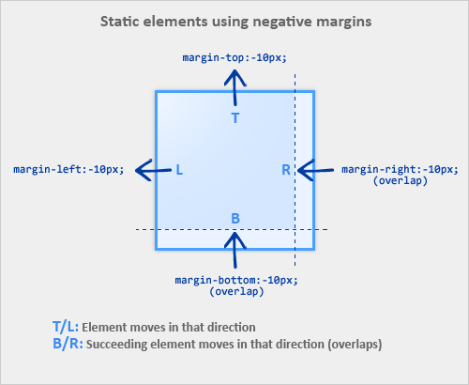
Negative Margin
Notes:
Source:https://www.smashingmagazine.com

Slide 13
The display property
The display property can be used to convert inline element to a block level and vice versa. **
To convert inline element like span to a block level element, use display:block
To convert block element like p to an inline element, use display:inline
Recall that inline elements can not respond to width and height, there is a 3rd value of display that allows you to specify width and height on inline element.
display:inline-block;
Inline-block makes the element behaves like a typical inline element in terms of just occupying the space it needs but will respond to width and height
We can leverage on this property to create an appropriate navigation bar
Notes:
There is also display:none which will hide the element completely

Slide 14
The display property: creating a search-engine friendly navigation bar
By convention, navigations are usually placed within a <ul>…<li> tag.
<ul>
<li> <a href=“”>Home</a></li>
<li> <a href=“”>About Us</a></li>
<li> <a href=“”>Contact Us</a></li>
</ul>
Since <li>… is a block level element, we can use the display:inline-block ; property to make each of them turn to horizontal menu bar

Slide 15
CSS BACKGROUND PROPERTY

Slide 16
Styling Your Page Background
The background of your webpage is the part underneath the webpage contents area*
The CSS background properties are used to define the background effects.
background-color: Sets a solid color for the background.
background-image: Specifies a background image to appear in the background of the element.
Notes:
Background doesn’t sit on the margin since the margin is an area outside the content of the element *
When using a background image, use an image that does not disturb the text

Slide 17
Background Properties
background-repeat: Specifies whether the background should be repeated (tiled) or not. Can be applied to repeat tiled background
Background-size: cover|contain | width and height
background-position: Specifies the position that the background should appear inside the element background.
background-attachment: Specifies the behavior of an element's background when its content scrolls. (Scroll with content or fixed?)
Notes:
The background image can be a static file, or a generated gradient.
The background color by default is transparent
Good to set background color as a fallback when using background-image property

Slide 18
BACKGROUND PROPERTY
The CSS background properties are used to define the background effects for elements.
The background shorthand property sets all the background properties in one declaration.
CSS background properties are:
background-color
background-image
background-repeat
background-attachment
background-position
background-size
Example:
background: violet url("img_tree.gif") no-repeat fixed center;
It does not matter if one of the property values is missing, as long as the other ones are in this order.

Slide 19
background-color
The background-color property specifies the background color of an element
In the example below, the <h1> and <p>elements have different background colors:
h1 {
background-color: tomato;
}
p {
background-color: violet;
}
Syntax:
background-color: color|transparent

Slide 20
Background-image
The background-image property specifies an image to use as the background of an element.
By default, the image is repeated so it covers the entire element.
Example:
body {
background-image: url("paper.gif");
}
Note: When using a background image, use an image that does not disturb the text.

Slide 21
Background-repeat
By default, the background-image property repeats an image both horizontally and vertically.
Some images should be repeated only horizontally or vertically, or they will look strange:
Example:
body {
background-image: url(“alumni.png");
background-repeat: repeat-x;
}
Tip: To repeat an image vertically, set background-repeat: repeat-y;
Also, background image can only be shown once.
background-image: url(“alumni.png");
background-repeat: no-repeat;
Syntax:
background-repeat: repeat|repeat-x|repeat-y|no-repeat

Slide 22
Background-position
The position of the image is specified by the background-position property:
Background-position: top | bottom | center (optionally combined with left | right)
Example:
body {
background-image: url("img_tree.png");
background-repeat: no-repeat;
background-position: right top;
}

Slide 23
Background-attachment
The background-attachment property specifies that the background image should be fixed (i.e. will not scroll with the rest of the page)
Example:
body {
background-image: url("img_tree.png");
background-repeat: no-repeat;
background-position: right top;
background-attachment: fixed;
}
Syntax:
background-attachment: scroll|fixed

Slide 24
Background-size
The background-size property specifies the size of the background image.
Example:
body {
background-image: url("img_tree.png");
background-repeat: no-repeat;
background-attachment: fixed;
background-size: 700px 500px;
}
background-size: contain;
Syntax:
Background-size: auto | cover | contain | width height

Slide 25
Background Shorthand
background-color
background-image
background-position
background-repeat
[background-attachment]
Background-size: cover | contain
body{
background: #ffffff url("tree.png") no-repeat right top;
}
Notes:
It does not matter if one of the property values is missing, as long as the other ones are in this order.

Slide 26

Assignment:
Create something similar to the following: a part of a real website:

Slide 27
CSS GRADIENT PROPERTY

Slide 28
CSS GRADIENT
In place of background image, CSS gradients let you display smooth transitions between two or more specified colors.
CSS defines two types of gradients:
Linear Gradients (goes down/up/left/right/diagonally)
Radial Gradients (defined by their center)

Slide 29
CSS LINEAR GRADIENT
To create a linear gradient you must define at least two color stops. Color stops are the colors you want to render smooth transitions among. You can also set a starting point and a direction (or an angle) along with the gradient effect.
Syntax:
background: linear-gradient(direction, color-stop1, color-stop2, ...);
background: radial-gradient(shape, color1 N%, color2 Y%,...)
Example:
#grad {
background: linear-gradient(to right, red , yellow); /*left to right*/
}
background: linear-gradient(to bottom right, red, yellow); /*diagonal*/
background: linear-gradient(45deg, red, yellow); /*angle*/ (may be –ve)
background: linear-gradient(to right, rgba(255,0,0,0), rgba(255,0,0,1)); /*transparent colors*/
background: radial-gradient(circle | ellipse, red, blue, yellow );

Slide 30
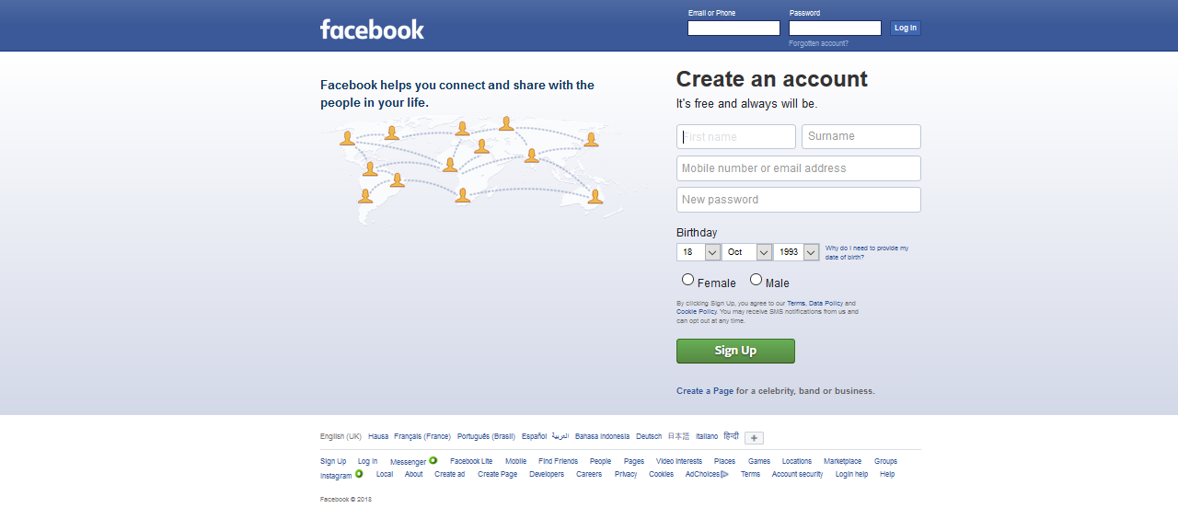
See Facebook background: a solid blue div on top of a bluish-white div, linear gradient can be used to achieve the bluish white bg, linear-gradient(to top, blue,white)*
Notes:
Example of Linear Gradient Applied
* Note: The right shade of blue

Slide 31
CSS DIV and Other Semantic Elements
Elements whose functions are self-explanatory

Slide 32
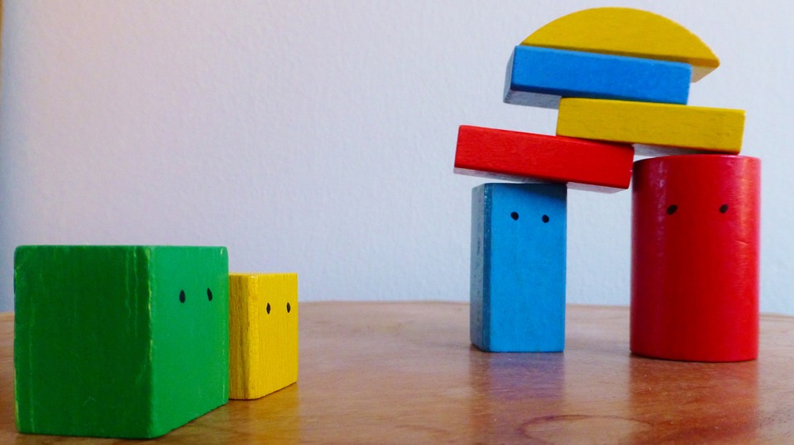
CSS DIV

Slide 33
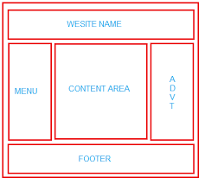
CSS DIV
The boxes, just like lego blocks can be put together to form a complete website.
The boxes which sit side by side are floated.
This layout is also known as the wireframe for your website.

Slide 34
Semantic Elements
The div is a generic block-level element that can be used to group web contents
A semantic element describes its meaning to both the browser and the developer. They describe the structure of a web document in a standard way thus making browsers and assistive technologies understand the page better.

Slide 35
HTML Navigational Element (<nav>) | defines a section that contains navigation links that appear often on a site. You can have primary and secondary menus, but you never nest, or put a <nav> element inside a <nav> element.
HTML Article Element (<article>) | defines a piece of self-contained content. It does not refer to the main content alone and can be used for comments and widgets.
HTML Section Element (<section>) | defines a section of a document to indicate a related grouping of semantic meaning.
NOTE: Articles can be nested inside of sections and sections can be nested inside of articles.
HTML Aside Element (<aside>) | defines a section that, though related to the main element, but has a different placement than the main content , like an explanation box, definition or an advertisement. It has its own outline, but doesn't belong to the main one. The <aside> element is often used for sidebars containing extra, but relevant, information
HTML Header Element (<header>) | defines the part of a page which typically contains the logo, title, and navigation. The header can also be used in other semantic elements such as <article> or <section> — or section header, containing perhaps the section's heading, author name, etc. <article>, <section>, <aside>, and <nav> can have their own <header>. Despite its name, it is not necessarily positioned at the beginning of the page or section.
HTML Footer Element (<footer>) | defines a page footer which typically contains the copyright, legal notices and sometimes some links — or section footer, containing perhaps the section's publication date, license information, etc. <article>, <section>, <aside>, and <nav> can have their own <footer>. Despite its name, it is not necessarily positioned at the end of the page or section.
HTML Blockquote | Indicates that the enclosed text is an extended quotation.

Slide 36
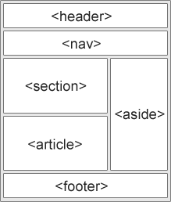
Semantic Elements

Slide 37
Designing for older browsers
Unknown elements are styled as display: inline by default, so you'll want to set them to display: block:
See example:
article, aside, footer, header, nav, section {
display: block;
}

Slide 38
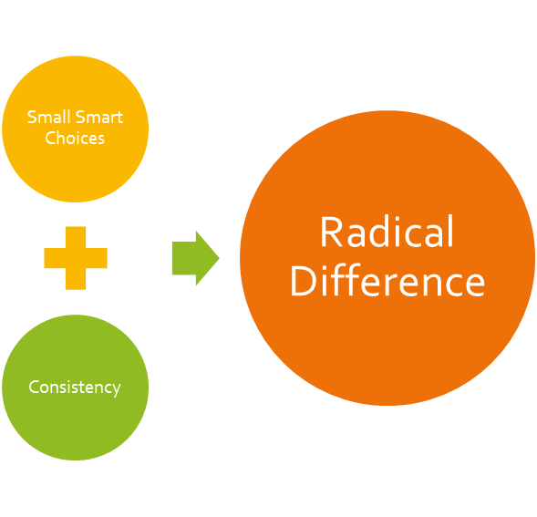
Catch up with all outstanding!
Well done, we are getting there…

